Slide 1
https://cat.2035.university/rall/?project_id=17&utm_source=karavaeva_albina&utm_medium=email&utm_campaign=podborka_kursov_coursera_17082021
https://cat.2035.university/rall/?project_id=42&utm_source=karavaeva_albina&utm_medium=email&utm_campaign=podborka_kursov_netology_17082021
https://steps.2035.university/collections/f60c26f9-9db7-40ef-ac94-e60cf50a87b0?utm_source=steps_karavaeva_albina&utm_medium=email&utm_campaign=podborka_kursov_steps_17082021
https://lectoriy.2035.university/?utm_source=lectoriy_karavaeva_albina&utm_medium=email&utm_campaign=podborka_kursov_lectoriy_17082021

Slide 3
1 этап

Slide 4
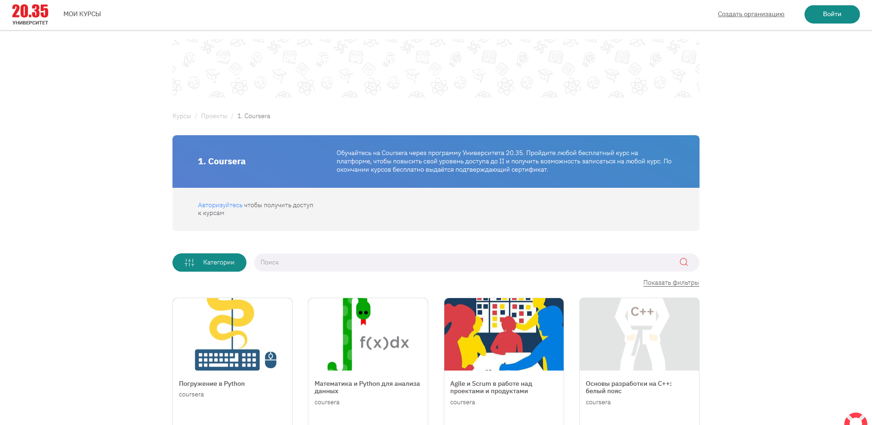
2 этап

Slide 5
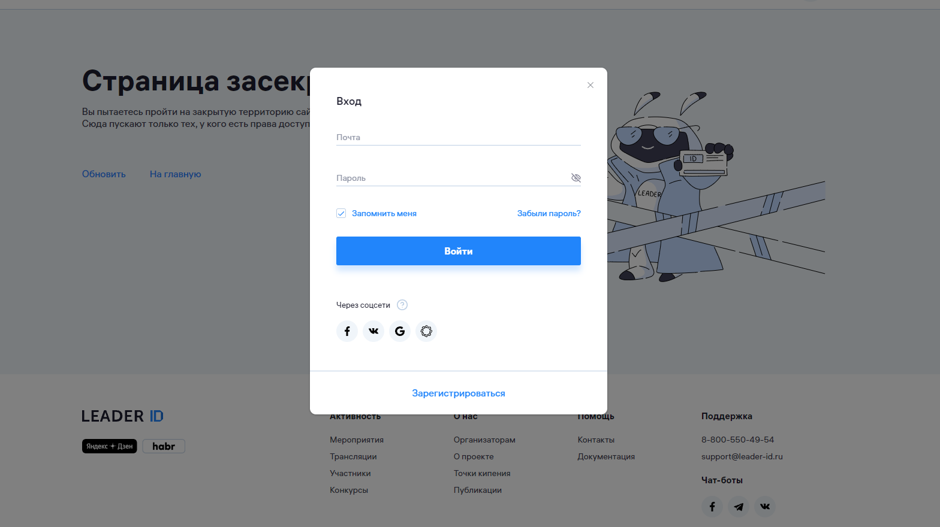
3 этап

Slide 6
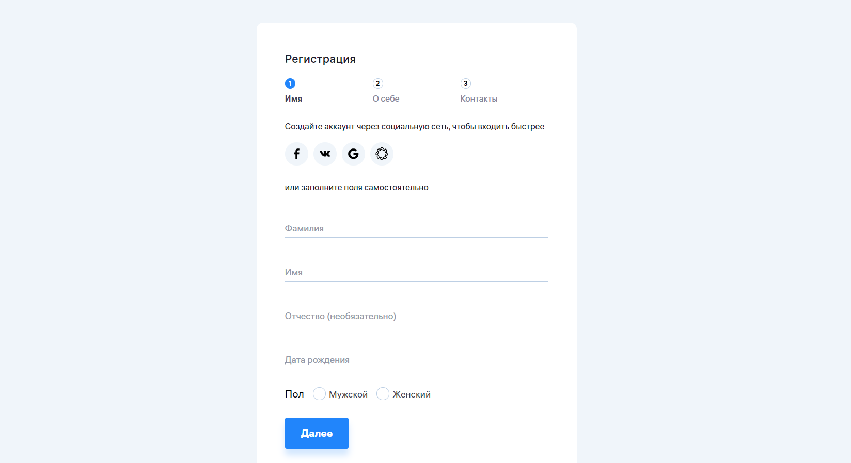

Slide 7
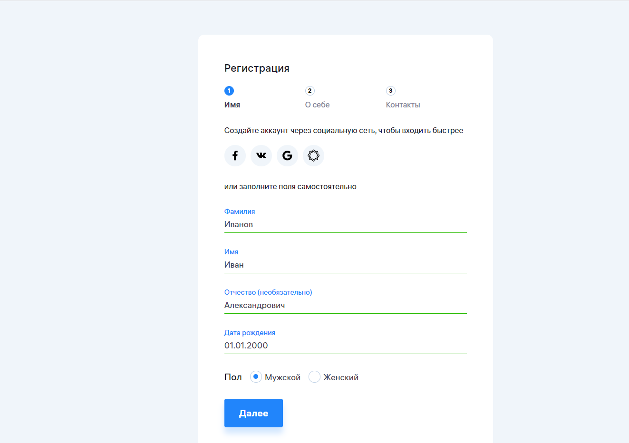

Slide 8
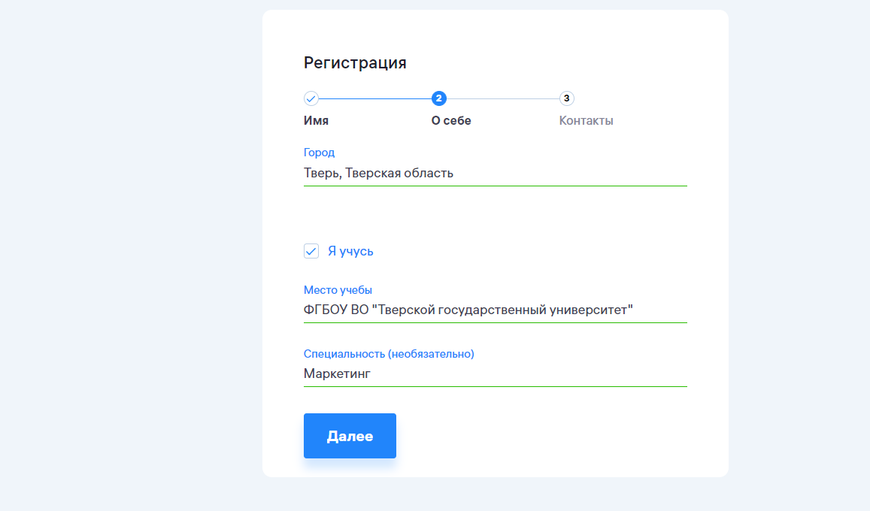

Slide 9
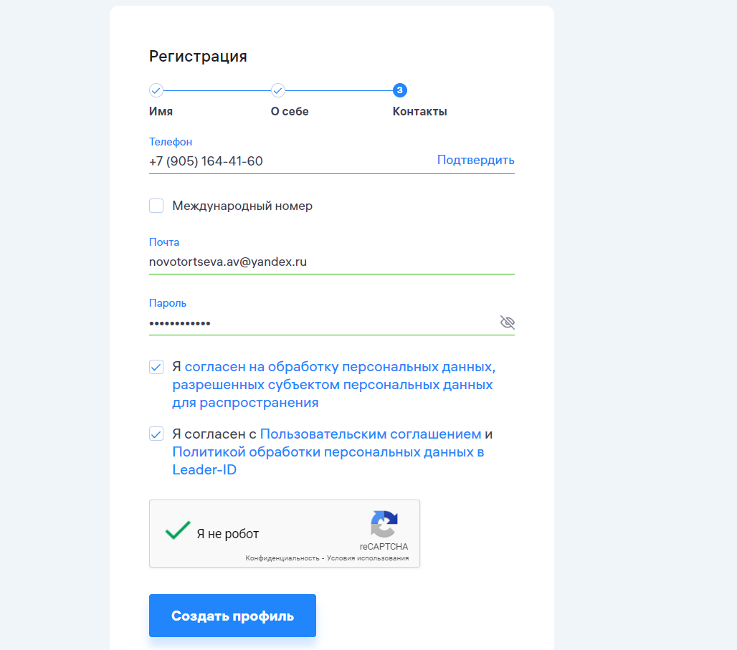

Slide 10
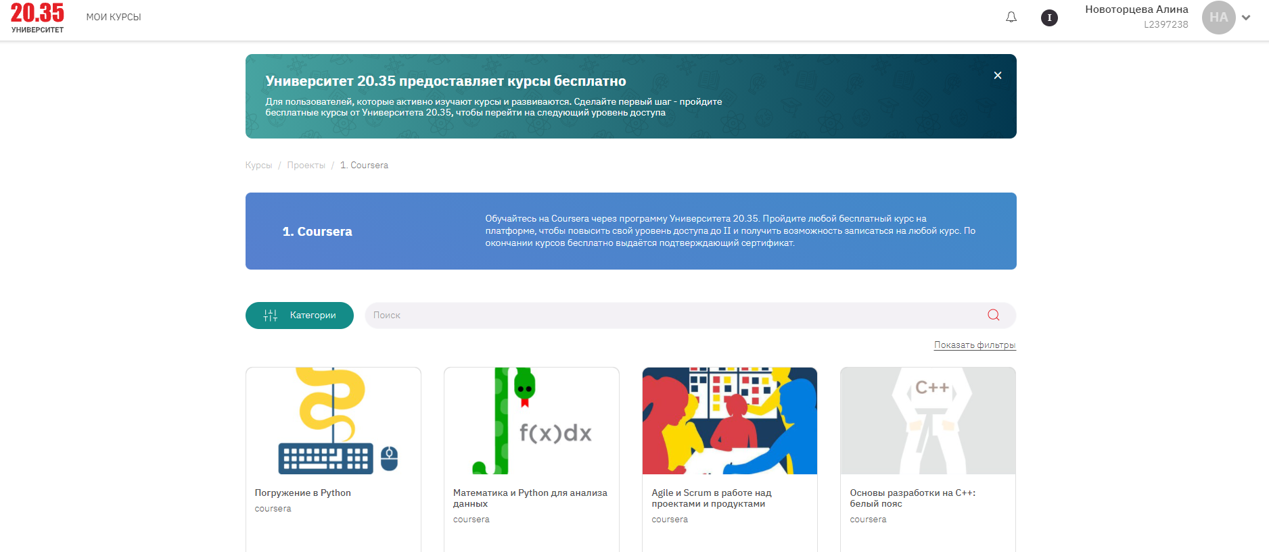
4 этап

Slide 11
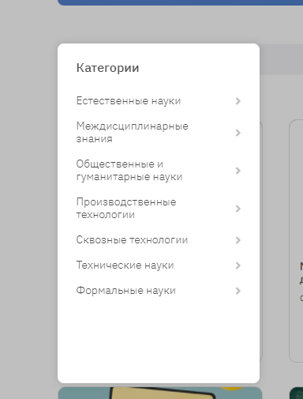
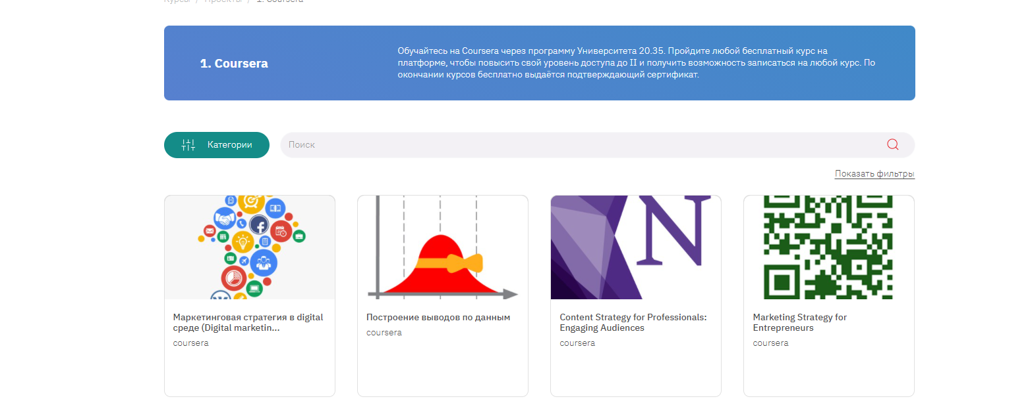
5 этап

Slide 12
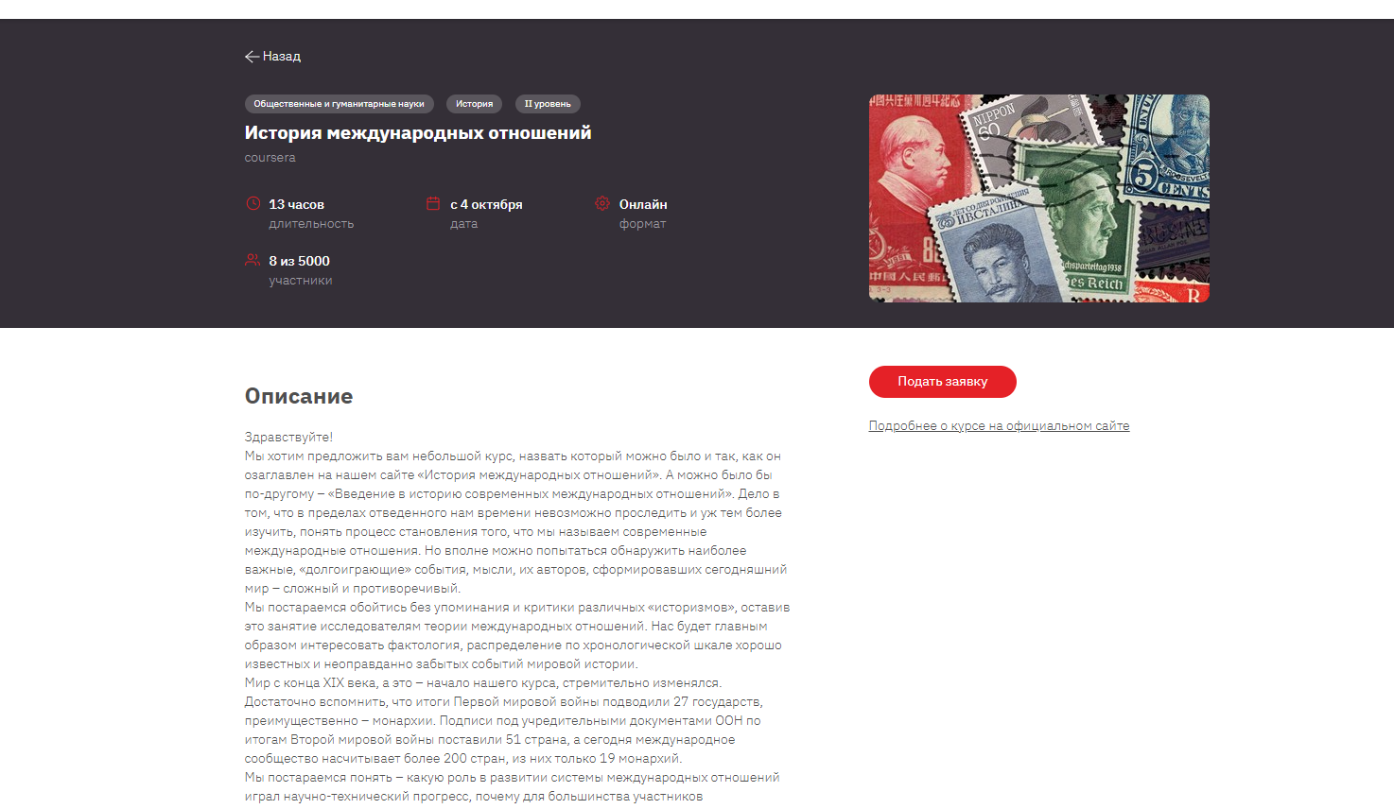
6 этап

Slide 13
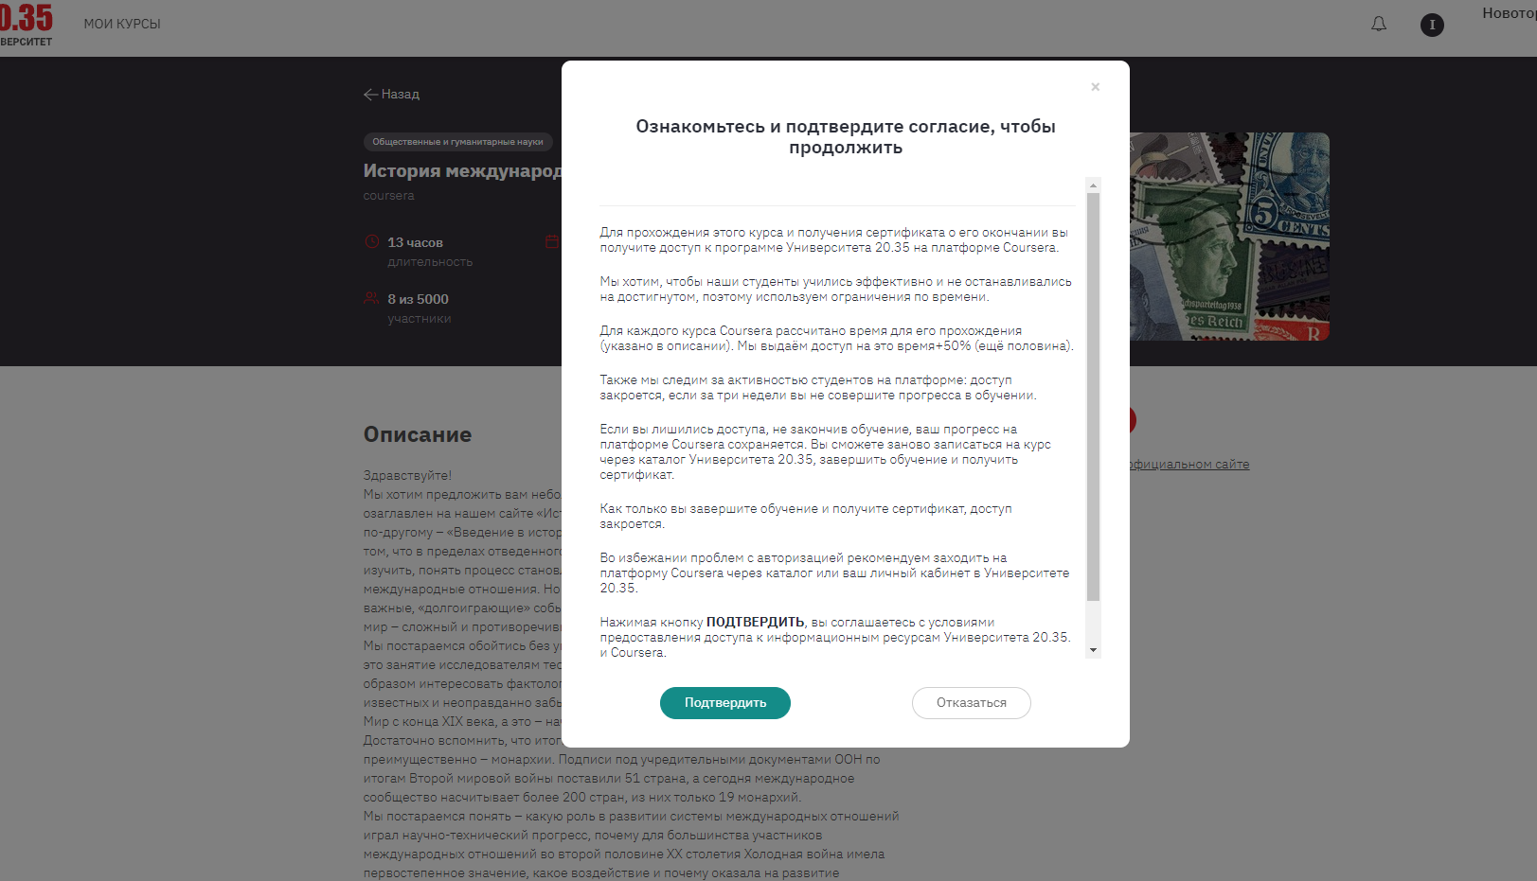
7 этап

Slide 14
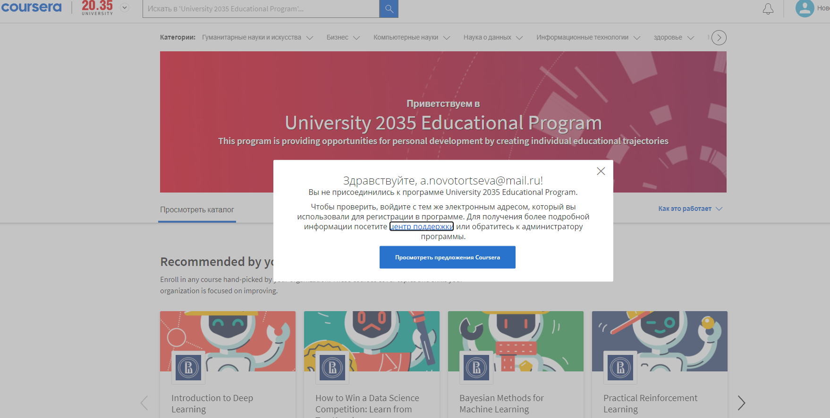

Slide 15
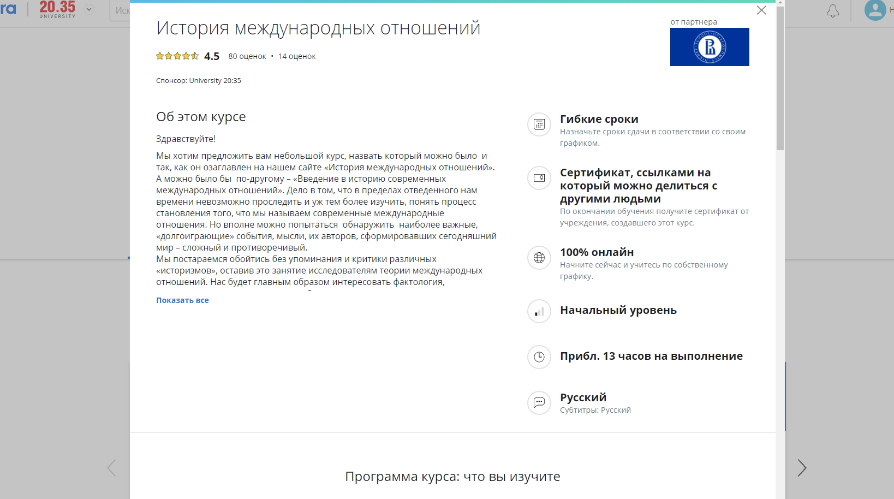
8 этап

Slide 16
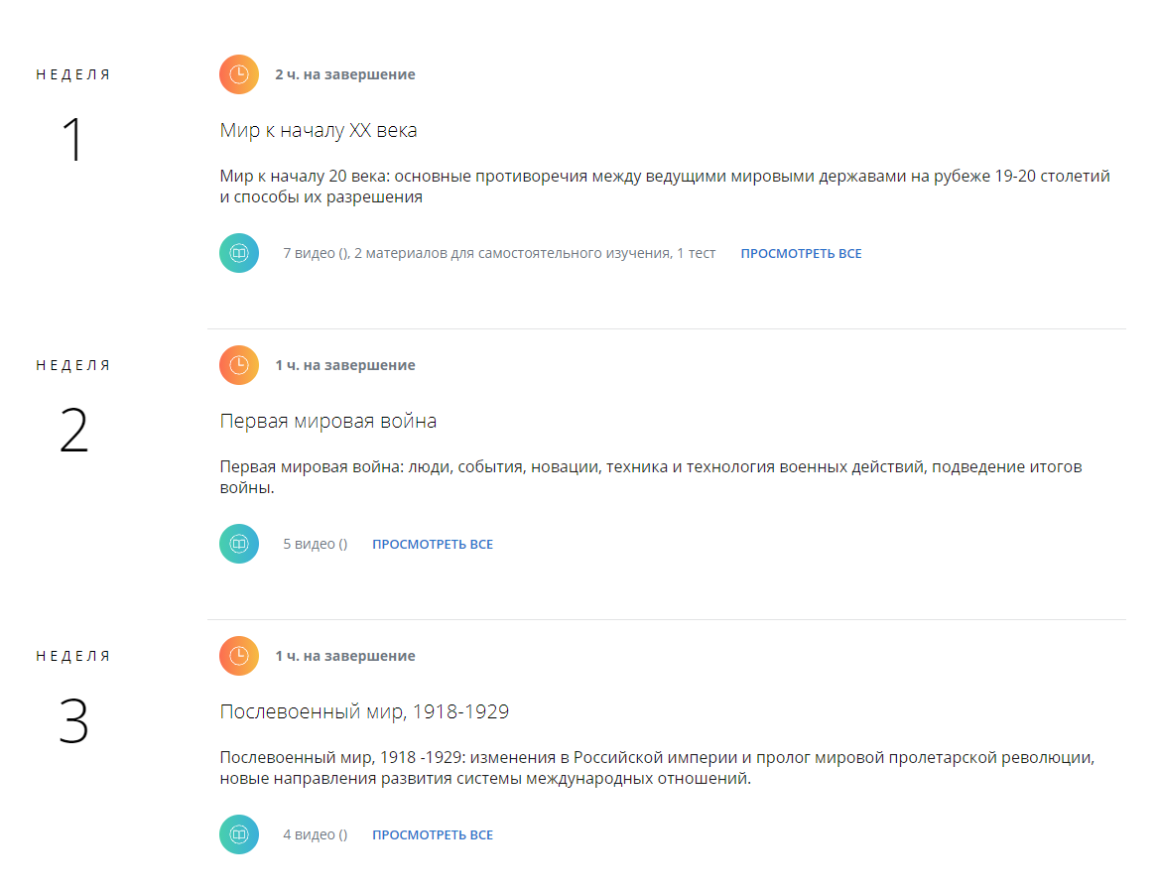

Slide 17
9 этап

Slide 19
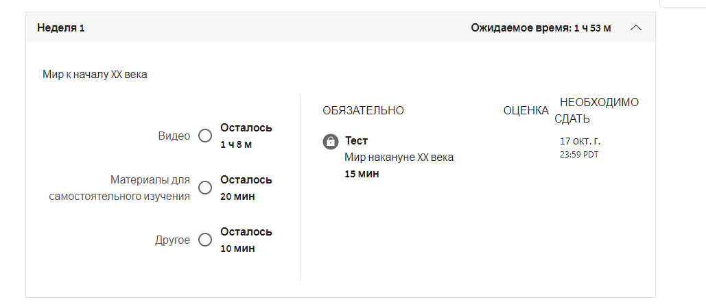

Slide 20
